Slide 1

Cvsu Go: A Gamified CVSU Bacoor Tour Experience
Andrei Parquez Joshua Santos
John Charles Belon Angelo Mendoza
Sairra Lagarto Rafaela Olivar

Slide 2
Background of the Organization
Mission
Cavite State University shall provide excellent, equitable and relevant educational opportunities in the arts, sciences and technology through quality instruction and responsive research and development activities. It shall produce professional, skilled and morally upright individuals for global competitiveness.
Vision
The premier university in historic Cavite globally recognized for excellence in character development, academics, research, innovation and sustainable community engagement.

Slide 3
Current State of Technology
In today's rapidly evolving technological landscape, there is a growing need for educational institutions to adopt more innovative and interactive approaches to campus navigation. One potential solution could involve the development of a gamified tour mobile application specifically tailored to the CVSU Bacoor Campus. Such an app could provide users with a dynamic and engaging way to explore the campus.

Slide 4
Current State of Technology
This gamified tour app would offer detailed maps of the campus, including building layouts, room numbers, and key facilities, making it easier for users to navigate through the campus. Users, including current visitors and first-year students, often inquire with guards to locate specific rooms or facilities, highlighting the need for a more accessible and efficient navigation system.

Slide 5
Proposed System
Introducing a mobile 2D game developed to assist both visitors and incoming freshmen in navigating and familiarizing themselves with the school environment, all without the need for a physical visit to the campus. This mobile game not only serves as an engaging and interactive platform but also ensures a seamless virtual exploration of the school's facilities, landmarks, and important points of interest.

Slide 6
Benefits of the system
Gamified Navigation: CVSU Go introduces an innovative approach to campus exploration, providing users with a captivating and enjoyable gamified navigation experience. By gamifying the navigation process, the application transforms mundane tasks into interactive challenges, making the journey across the campus an engaging adventure. This not only enhances the overall experience for users but also encourages a sense of excitement and curiosity, particularly beneficial for freshmen and visitors.

Slide 7
Benefits of the system
Promotes the School: In addition to facilitating efficient navigation, CVSU Go serves as a dynamic tool to promote the school. Through the gamified elements embedded within the app, users are not only navigating but also discovering various aspects of the institution. This promotes a deeper understanding of the campus layout, facilities, and culture, fostering a positive and immersive connection with the school

Slide 8
Benefits of the system
User-Friendly Interface: CVSU Go boasts an intuitively designed user interface that ensures a seamless navigation experience and facilitates quick information retrieval. The interface prioritizes simplicity and accessibility, allowing users of all technological proficiencies to effortlessly engage with the application. With clear and concise menus, interactive maps, and easy-to-use features, CVSU Go promotes inclusivity and ensures that users can maximize the benefits of the gamified navigation experience without any technical barriers

Slide 9
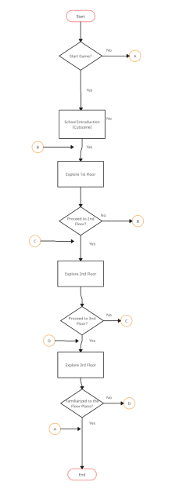
Flowchart

Slide 10
System Requirements
To ensure smooth operation and optimal performance of the software application, please adhere to the following system requirements:
● Operating System: Android Marshmallow (6.0) or later
● RAM: Minimum 2 gigabytes required
● Storage: Approximately 60 megabytes required for installation and operation.

Slide 11
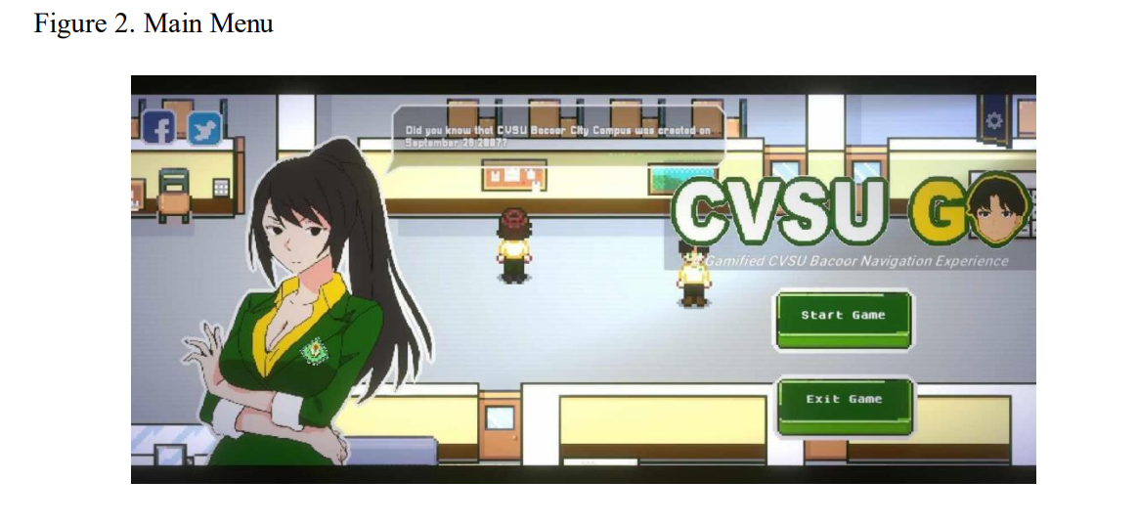
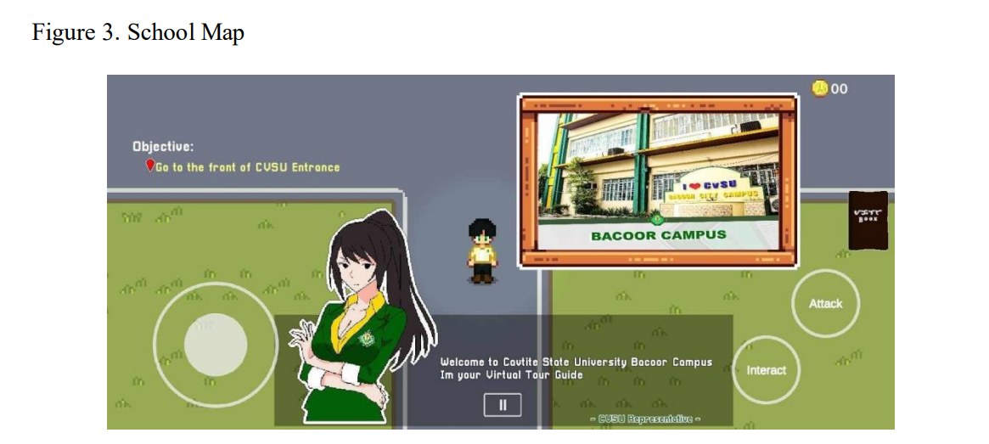
User interface requirements

Slide 12
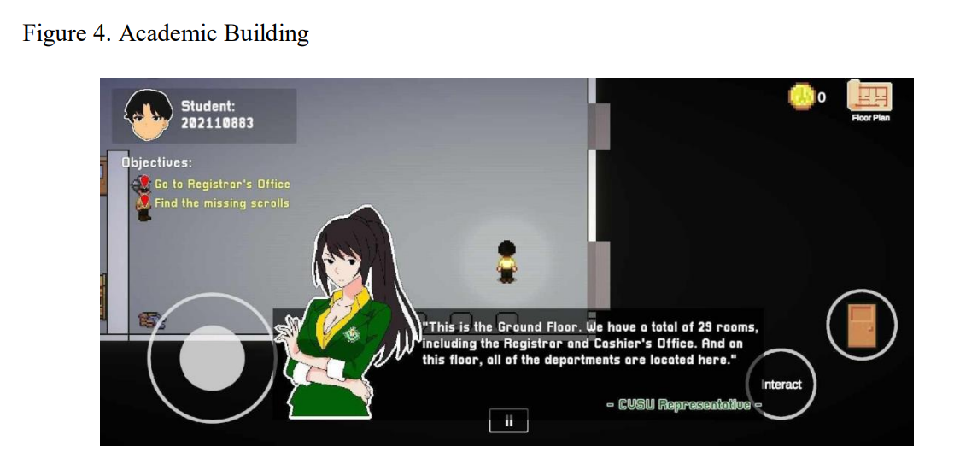
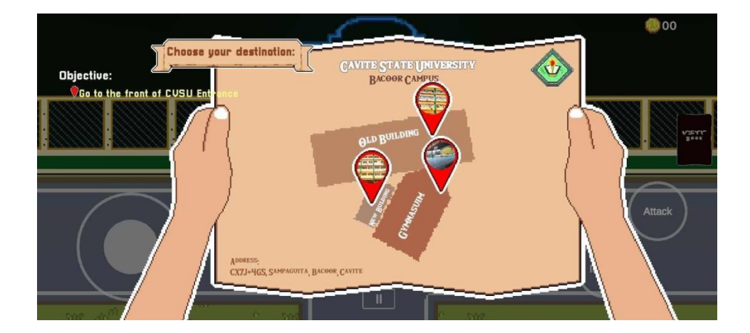
User interface requirements

Slide 13
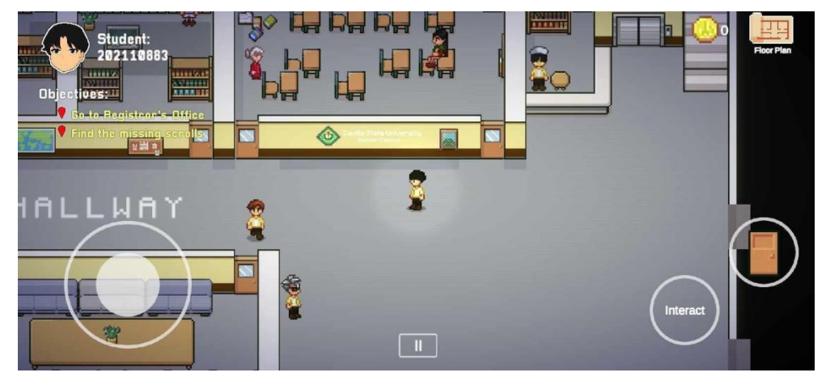
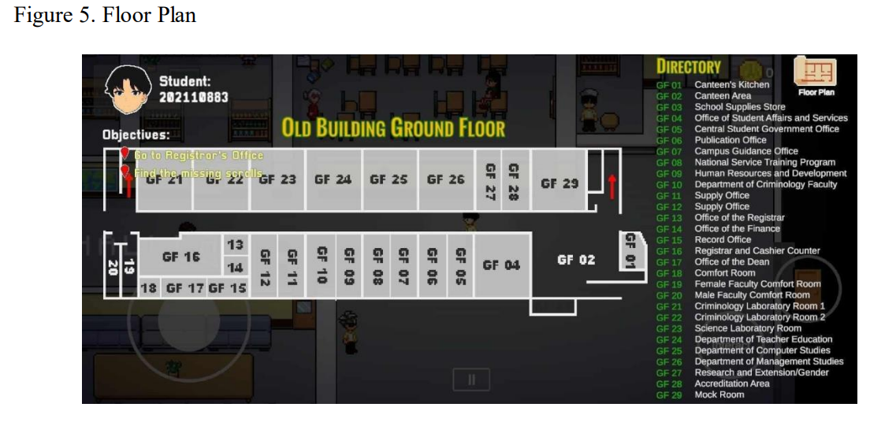
User interface requirements

Slide 14
Significance of the study
Visitors: The study holds paramount significance for visitors as it provides them with an innovative and user-friendly tool for exploring the campus without the need for a physical visit. Visitors can virtually navigate the school's premises, gaining insights into its facilities, landmarks, and overall environment. This virtual exploration not only saves time but also offers a unique and engaging experience, ensuring that visitors leave with a positive impression of the institution.

Slide 15
Significance of the study
1st Year Students: For1st Year Students, the study is of immense importance as it eases the daunting transition to a new academic environment. CVSU Go offers a gamified and interactive means for freshmen to familiarize themselves with the campus layout, locate key facilities, and access important information. By transforming the introduction to the school into a playful experience, the study contributes to a smoother adaptation process, reducing anxiety and fostering a sense of belonging from the very beginning of their academic journey.

Slide 16
Significance of the study
School: The school, as a whole, stands to gain significantly from the implementation of CVSU Go. The application acts as a promotional tool, showcasing the institution's commitment to innovation and technological integration. Moreover, by enhancing the overall experience for visitors, freshmen, and current students, CVSU Go contributes to a positive and vibrant campus culture. The study underscores the school's dedication to providing cutting-edge solutions for its stakeholders, aligning with its mission to offer quality education and foster a conducive learning environment.

